Slide 1


E-Health Care Facilities
K J College of Engineering & Management Research
Computer Department
Project By -
Aanchal Oswal
Mustafa Badshah
Rohit Pitre
Vachana Shetty
Project Guide -
Prof. Manali Vashi
Sponsored by Persistent Pvt Ltd.
Mentor – Saurabh Vaidya

Slide 2
Outline
Introduction
Motivation
Literature Survey
Existing System
Proposed System
Scope of Project
Modules
Software & Hardware Requirements
Future Scope
Conclusion
References

Slide 3

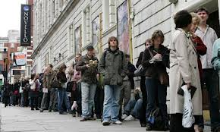

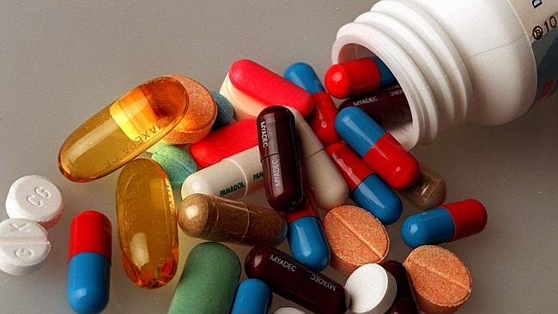
Introduction
Current Problems
Classification of Disease
Long Queues
Lost Directions
Missing Medication

Slide 4
Motivation
High Perception
High Interest
Use of Technology for Mankind Benefit
www.cdc.gov

Slide 5
Literature Survey
Paper Name | Author | Algorithm/Methodology | Disease predicted | Limitations/Disadvantages | Various Measures used
Breast cancer diagnosis using machine learning algorithms – A Survey | B.M. Gayathri, C.P.Sumathi and T.Santhanam | Machine learning algorithms- SVM, RVM & Neural Networks | Breast Cancer | SVM is less accurate as it predicts two classes for any given input as compared to RVM and Neural Networks | Accuracy
An amalgam KNN to predict Diabetes Mellitus | NirmalaDevi.M, Appavu Balamurugan, Swathi U.V | Amalgam of K-means and K-NN | Diabetes | It is lazy learner. There is no thumb rule to determine value of parameter k (Number of nearest neighbours). | Accuracy, sensitivity and specificity
Medi Query-An Automated Decision Support System | Rahul Isola, Rebeck Carvalho, Amiya Kumar Tripathy | Back propagation | Multiple Diseases | Using Euclidean distance method for classification, increases complexity of algorithm, classification becomes slower. LAMSTAR will assign weights to the examples and according to assigned weights, classification will be done. | Time, Complexity

Slide 6
Paper Name | Author | Algorithm/Methodology | Disease predicted | Limitations/Disadvantages | Various Measures used
Decision Tree Discovery for the Diagnosis of Type II Diabetes | Asma A. AlJarullah | J48 Decision Tree Algorithm & C4.5 | Diabetes | There are other risk factors that the data collection does not consider. Dataset contains data of only female patients. | Accuracy – 78.1768%
Predicting the Analysis of Heart Disease Symptoms Using Medicinal Data Mining Methods | V. Manikantan & S. Latha | K-Mean based MAFIA with ID3 and C4.5 | Heart disease | Prediction of heart attack using patient prescription is not included. | Accuracy – 92% Precision – 0.82
Classification of Heart Disease Using K- Nearest Neighbor and Genetic Algorithm | M.Akhil jabbar, B.L Deekshatulu & Priti Chandra | KNN and genetic algorithm | Heart disease | (KNN+GA) was not successful for breast cancer and primary tumour. As the k value goes on increasing accuracy of data sets is decreasing. | Accuracy – 95.73%

Slide 7
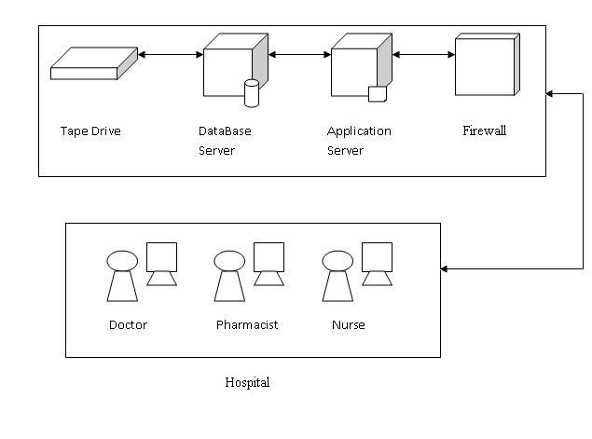
Existing System

Slide 8
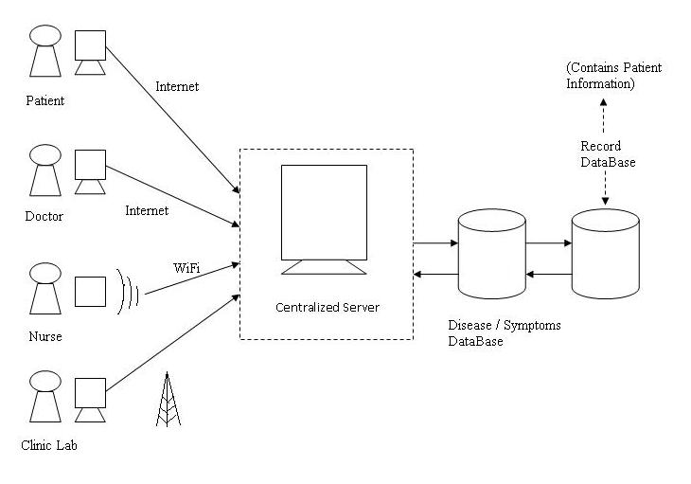
Proposed System

Slide 9
Scope of Project
Appointment confirmation is through the application itself.
Notification reminders for appointments and medication.
Disease Diagnosis is limited to generalized diseases.
Application is supported by Android only.

Slide 10
Modules
HOSPITAL MODULES
Profile Management
Prescription Management
Clinic Management
PATIENT MODULES
Profile Management
HealthCare Scheduling
HealthCare Reminders
Location Based Emergency Service
Disease Prediction

Slide 11
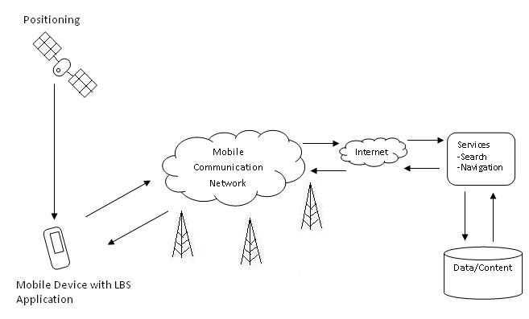
Location Based Emergency Service

Slide 12
Disease Prediction
Enter Symptoms
Get ID of symptoms
Calculate Probability of Disease Predicted
Map Diseases to Symptom ID
Return Predicted Diseases and Probability
Get Symptom Count of Mapped Diseases
Predict Recent Trends of Diseases
Get Total Weight of Disease Symptoms

Slide 13





Technologies Used
Android Developer Tools(ADT)
MySQL Database
PHP
Bootstrap
Backbone
Eclipse IDE
Blue Stacks

Slide 14
Implementation Details
GUI for Hospital Module has been built on Bootstrap and BackBone.
GUI for Patient Module has been built on ADK (Android Development Kit)
Schema has been made on MY-SQL server.

Slide 15
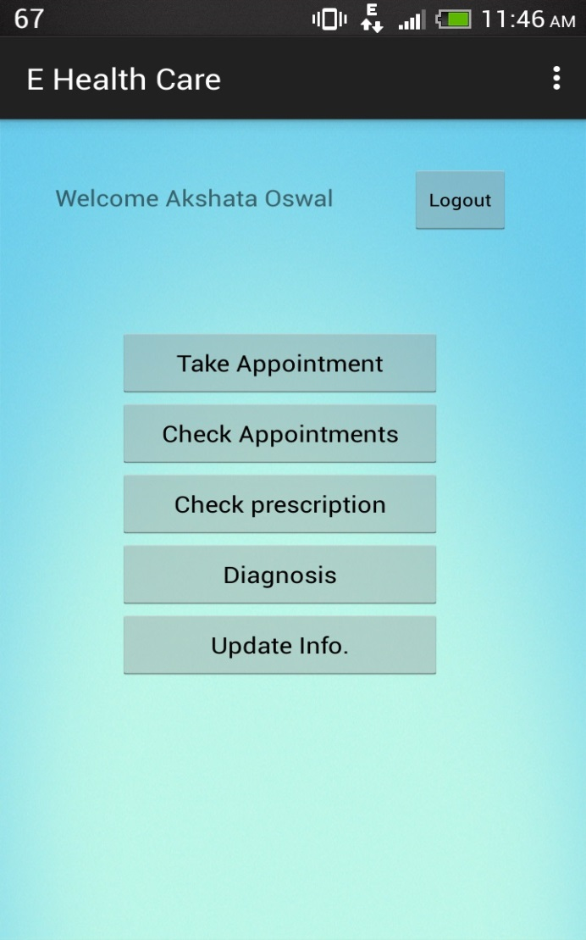
HOME PAGE

Slide 16
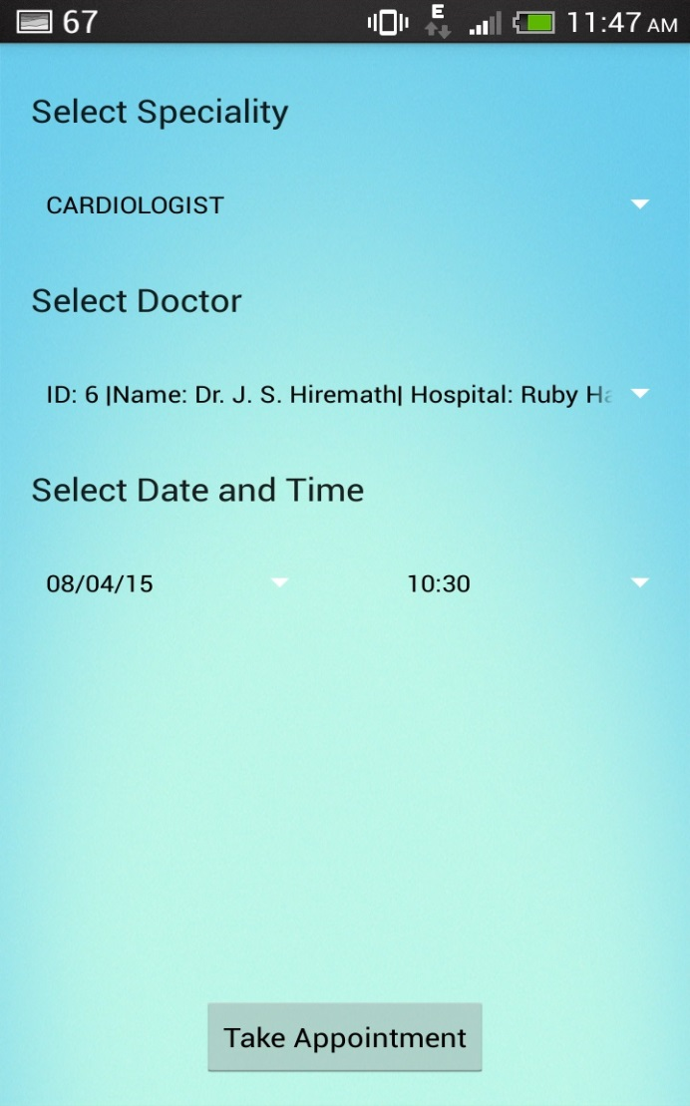
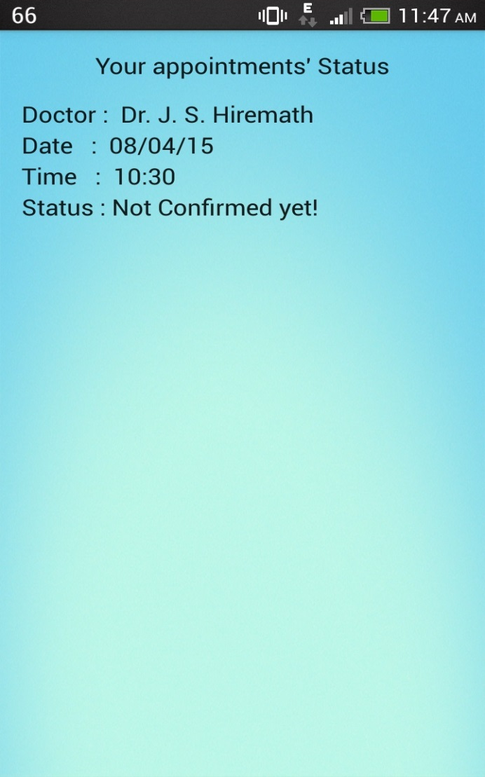
APPOINTMENT

Slide 17
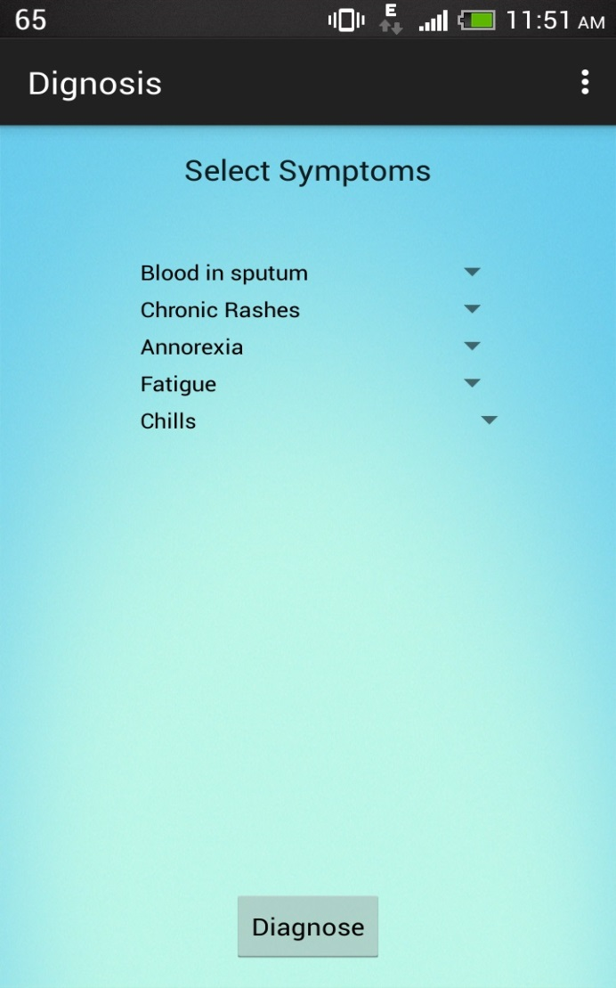
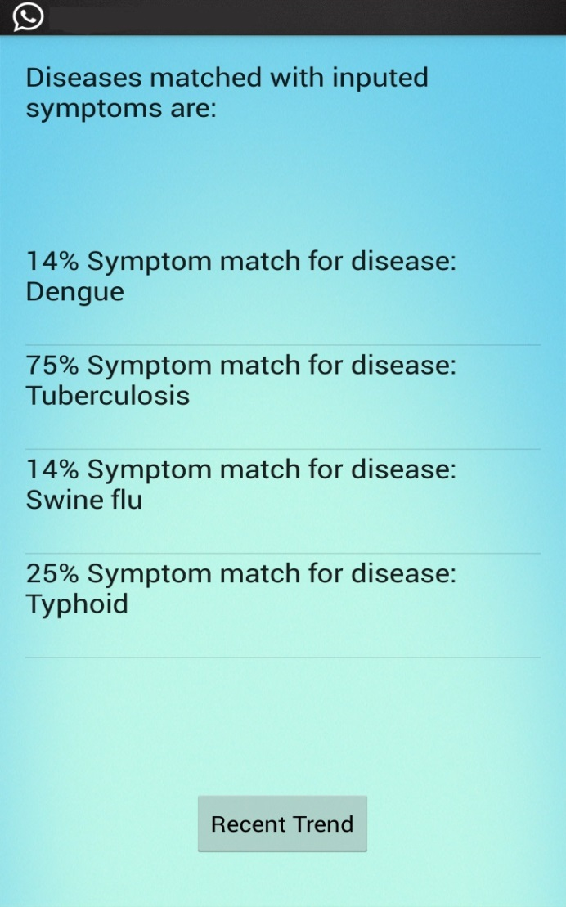
DISEASE PREDICTION

Slide 18
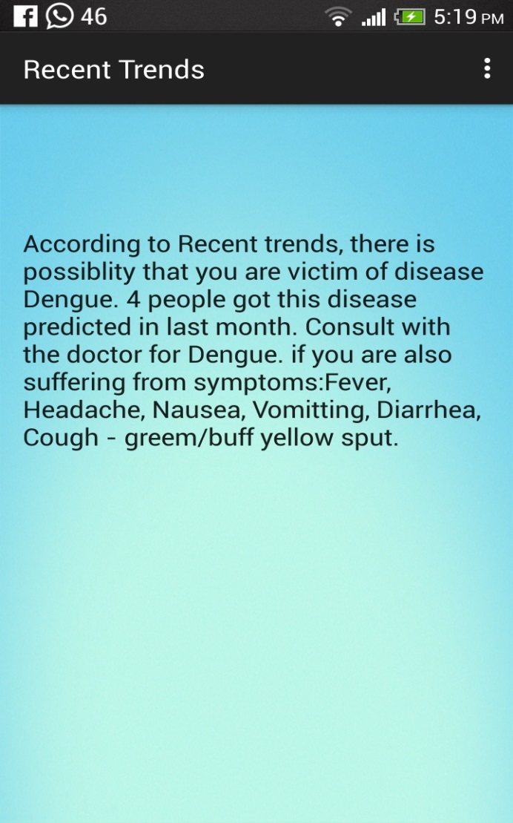

Slide 19
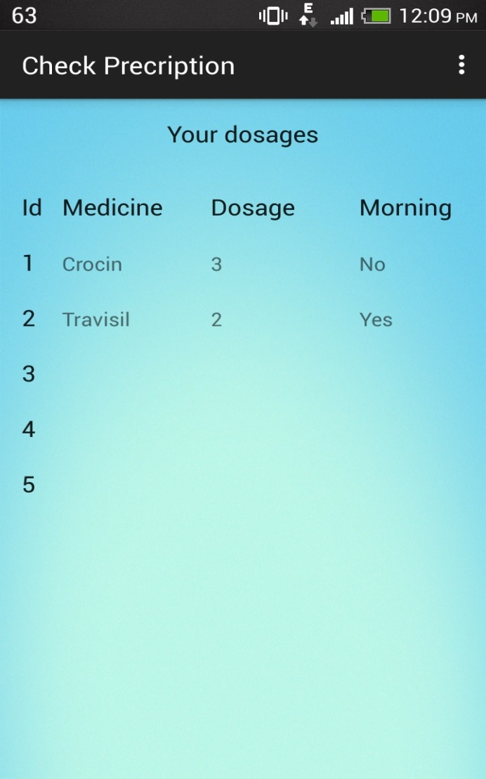
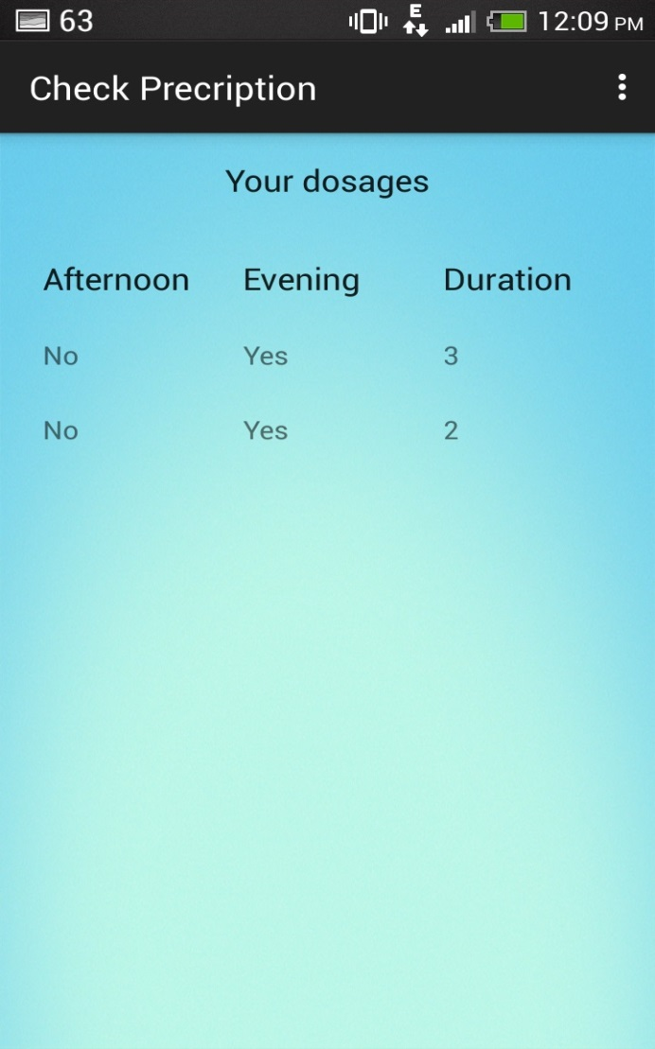
CHECK PRESCRIPTION

Slide 20
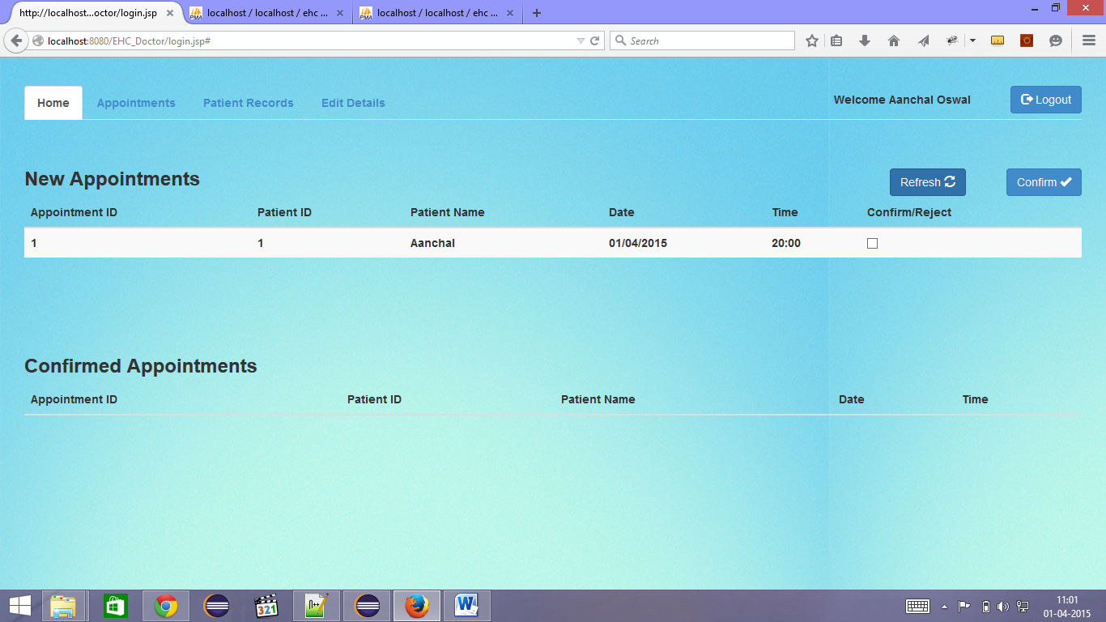

Slide 21
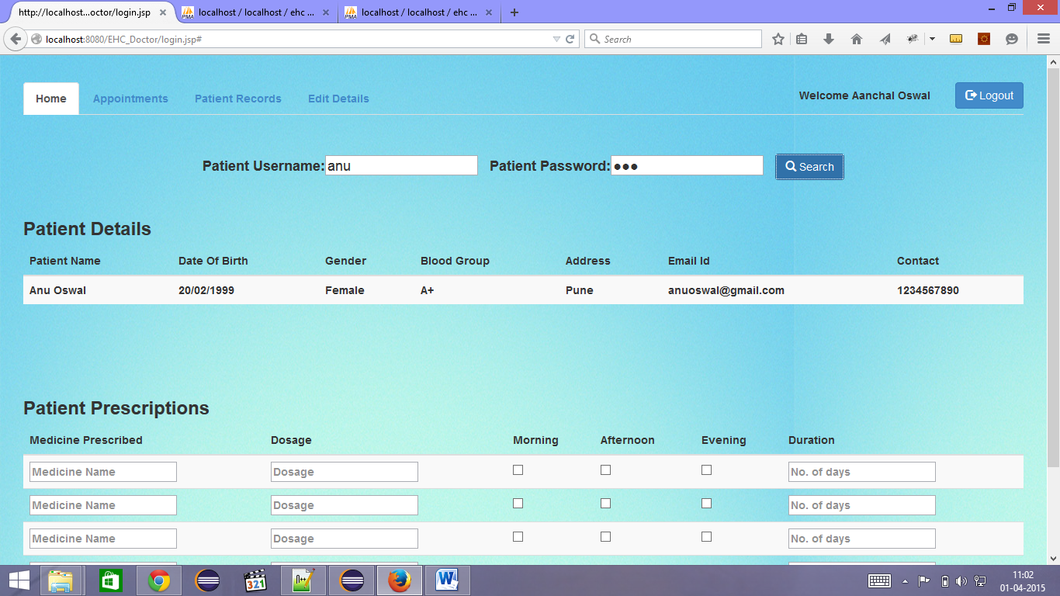

Slide 22
Future Scope
Our system is scalable and can be implemented globally.
Data mining features can be extended to various other diseases and drug interactions.
Emergency Services can locate us through GPS at times of critical emergencies.

Slide 23
Conclusion
There are various advantages of having such an application and due to the increasing demand of health records, there is an inherent need of such an application.
User-friendly
Less time consuming
Saves Paper

Slide 24
Thank You

Slide 25
References
Ming Li, Member, IEEE, Shucheng Yu, Member, IEEE, Yao Zheng, Student Member, IEEE, Kui Ren, Senior Member, IEEE, and Wenjing Lou, Senior Member, IEEE “Scalable and Secure Sharing of Personal Health Records in Cloud Computing Using Attribute-Based Encryption”, IEEE TRANSACTIONS ON PARALLEL AND DISTRIBUTED SYSTEMS, VOL. 24, NO. 1, JANUARY 2013
NirmalaDevi.M, Appavu alias Balamurugan.S, Swathi U.V, “An amalgam KNN to predict Diabetes Mellitus.”
Predicting the Analysis of Heart Disease Symptoms Using Medicinal Data Mining Methods
Android App Development with Java Essential Training –www.lynda.com
www.developer.android.com

Slide 26
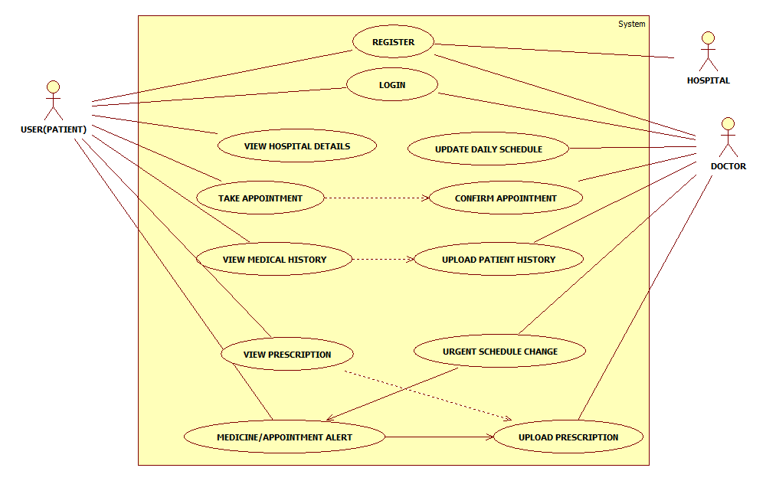
Use Case Diagram

Slide 27
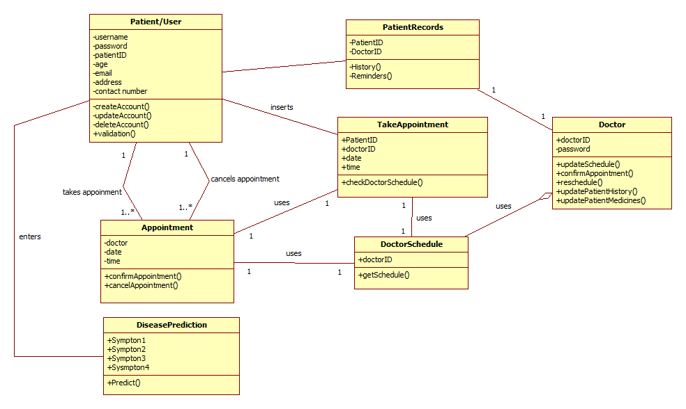
Class Diagram

Slide 28
Database example
Sr. No. | Disease Name | Signs or Symptoms | Diagnosis
1. | Chicken Pox | Prodromal symptoms Characteristic rash Oral cavity sores | Examination of fluid within the rash Blood testing
2. | Cholera | Watery diarrhoea Vomiting Dehydration Greyish-Bluish skin(severe cases) Muscle cramps & weakness | Oral rehydration Anti-bacterial drugs Collect stool & swab samples
3. | Common cold | Coughing Sore throat Runny nose Sneezing Fever Sometimes even: Muscle ache Fatigue Headache Loss of appetite | Get plenty of rest & fluids Vitamin C, zinc supplements and Echinacea
4. | Dengue | Fever Headache Muscle & joint pain Characteristic skin rash Nausea & vomiting | Physical examination Checking of WBC count
5. | Leprosy | Inflammation of: Nerves Respiratory tract Skin Eyes Poor eyesight Lack of ability of pain (sensory loss) | Leprostatic agents used for treatment Multi-drug therapy(MDT)
6. | Measles | Cough Cold Conjunctivitis Itching | Use of IgM antibodies Salivary measles treated by IgA testing Observation of Koplik’s spots
7. | Pneumonia | Cough Chest pain Fever Difficulty in breathing | X-rays Culture of sputum Antibiotics
8. | Allergy | Itchy eyes Drippy/stuffy nose Rashes Face swelling Stomach upset Oesophagus swells up | Use of epinephrine drug

